Slide 1

TEAM 4 / CAPSTONE PROJECT
CampusVibes
Your campus. Your vibe.
WEEKLY PROGRESS PRESENTATION
22 October 2026
Presented by Ujjal • Devyana • Tulasa • Prachi
DISCOVER • CONNECT • BELONG
Notes:
Hello, we are Ujjal, Deviyana, Tulasa and Prachi from Team 4. Today, 22 October 2026, we'll present CampusVibes, our campus event discovery and community project.

Slide 2
TEAM 4 / CAMPUSVIBES
The idea: one campus, one place
Target Users: Students who wants to discover campus events, clubs, and activities
Discover
Connect
Belong
Find events and clubs
See campus conversations
Make campus life personal
Campus activities are easier to join when students can find them.
Notes:
CampusVibes combines event discovery, community updates, and personal student features.

Slide 3
TEAM 4 / CAMPUSVIBES
The problem and our solution
THE PROBLEM
OUR SOLUTION
Event information is scattered.
Students may miss activities or struggle to find details.
One platform for browsing events, viewing campus updates, and managing interests.
Notes:
We want to reduce the effort required to discover and engage with campus activities.

Slide 4
TEAM 4 / CAMPUSVIBES
Current Demo path
A clear path from discovering an event to participating in campus life.
Landing Page
Login / Authentication
Dashboard
Introduce CampusVibes and its purpose.
Log in using the verified demo account.
Briefly introduce the main navigation.
Search / Filters
Discover / Events
Event Details
Search events, apply filters, and show the no-results behavior.
Browse available sample events.
Open an event and display its basic details.
Supporting features, if time permits: Saved Events, Profile, Assistant, Suggestions, social features, and the light/dark theme toggle.
Notes:
These are our supporting features

Slide 5
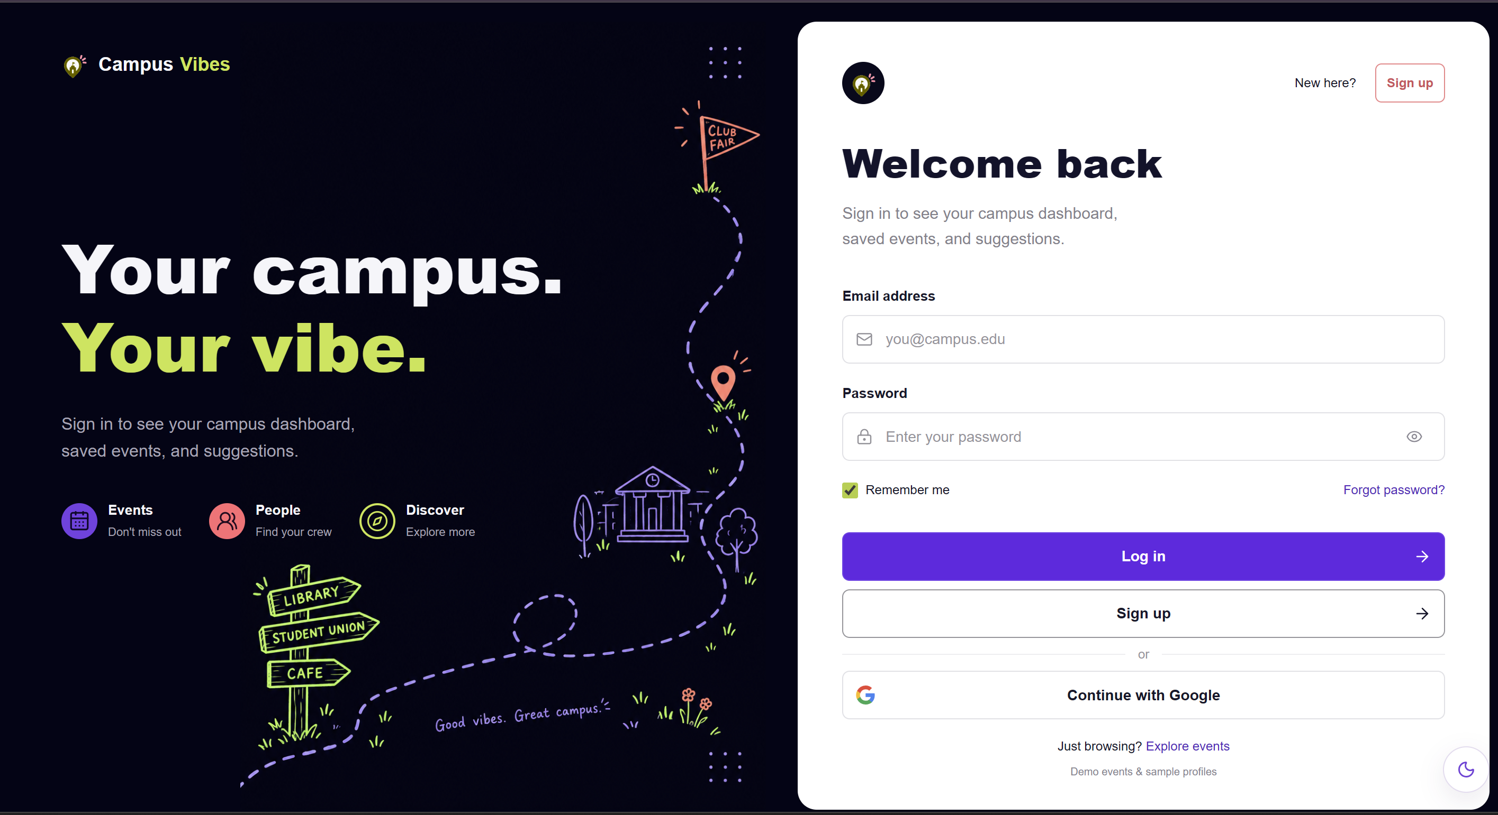
TEAM 4 / CAMPUSVIBES
Landing Page
Live demo
• Introduces CampusVibes and its purpose
• Provide entry point to login or create account

Slide 6
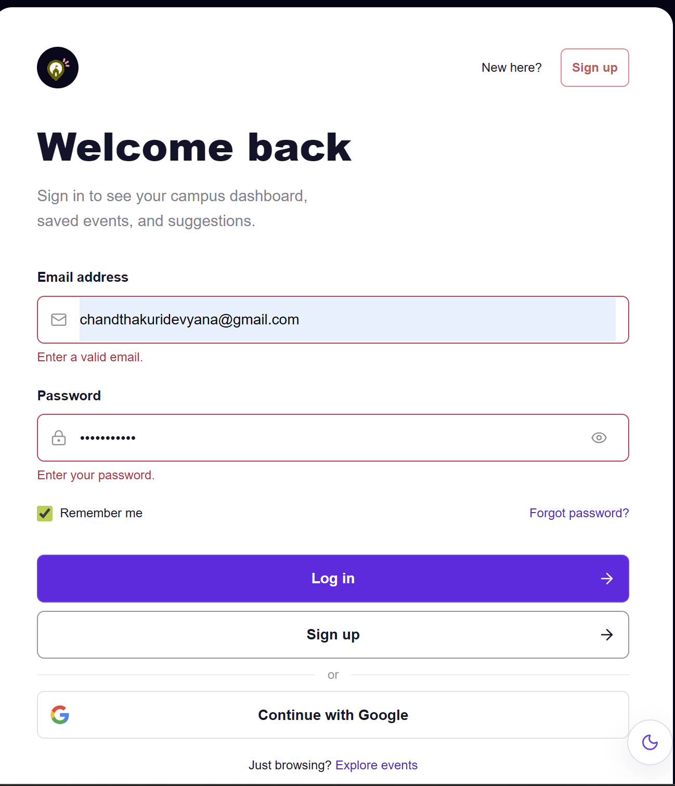
TEAM 4 / CAMPUSVIBES
Login or Signup
Email/password login and registration using Firebase Authentication.
Logout and authentication persistence
Demo with verified student account.

Slide 7
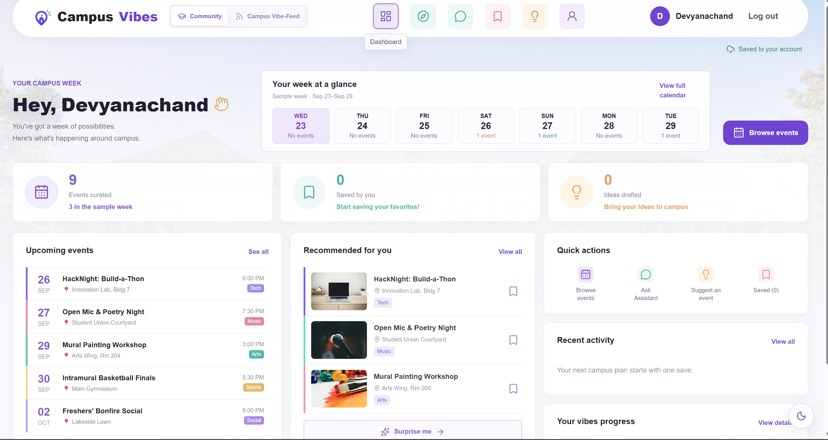
TEAM 4 / CAMPUSVIBES
Dashboard
Main navigation for all sections.
Quick access to events, saved items, profile and more.

Slide 8
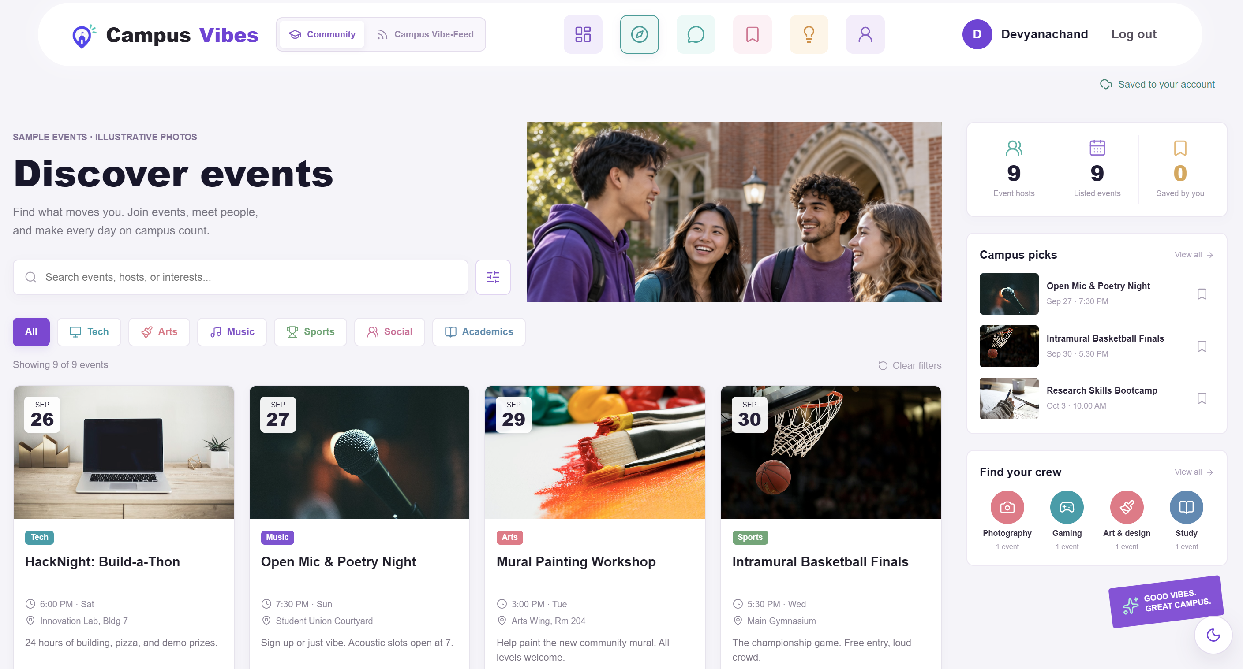
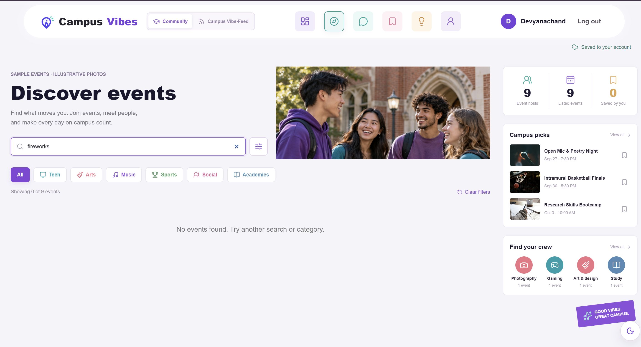
TEAM 4 / CAMPUSVIBES
Discover campus events
• Browse available sample events
• Filter by categories and interests
• Explore event cards and campus picks
• Empty-search/ no result behavior tested and recorded
Notes:
This is our real Discover page, with event cards, category filters, and recommendations.

Slide 9






TEAM 4 / CAMPUSVIBES
Supporting Features
Saved Events
Profile
Assistant
Save and view your favorites events
View and edit profile information
Get events suggestion with local answer engine
Suggestions
Social Features
Light/Dark mode
Submit your ideas
Connect, message and share (demo data and persistence limits)
Switch between Dark/Light theme

Slide 10
TEAM 4 / CAMPUSVIBES
Current limitations
What works now and what still needs improvement
Firestore Event Loading: Events currently use code-based sample data. Firestore event loading has not been verified.
Authentication: Google sign-in and password-reset completion still require end-to-end verification.
Push Notifications: Browser and mobile push notifications are not implemented.
Assistant: Uses a local answer engine and sample data, not a live AI service or live campus data.
Data Persistence and Social Features: Some demo data is stored locally and may not sync across accounts or devices. Guest social interactions are not delivered to other students.
Other Features: Feed photo attachments are disabled, approving suggestions does not automatically publish them to Discover, and ticket purchasing is outside the current midterm scope.
Notes:
We will prioritize testing, backend readiness, and a polished final demonstration.

Slide 11
TEAM 4 / CAMPUSVIBES
Testing and Evidence
Main User Flow Testing
Tested the main event discovery journey, from browsing events to viewing event details.(Issue#64)
Independent Demo Rehearsal
Rehearsed the deployed website independently on desktop and mobile devices.(Issue#53)
Empty Search / No Results
Recorded test results and supporting evidence in GitHub issues.(Issue#70)
Theme toggle
Toggle evidence(Evidence)
Firestore Limitation
Event loading remains unverified(Issue#35)
Outcome: Verified key user flows and documented testing results for the midterm demonstration.

Slide 12
TEAM 4 / CAMPUSVIBES
Evidence links
Repository
CampusVibes Team 4 Repository
Deployment
Open CampusVibes Website
Testing Issues :Issue #53 — Independent Deployed-Demo RehearsalIssue #64 — Events → Event Details RetestIssue #70 — Empty-Search / No-Events TestIssue #35 — Firestore Limitation
Theme Toggle
Theme Toggle Code Commit and Evidence
Additional Evidence
Issue #63 — Retest Evidence / Follow-up
View Repository Commits

Slide 13
TEAM 4 / CAMPUSVIBES
Contribution summary
Prachi
prachi2061
• Navigation & event imagery
• Supporting features & Gemini
• Automated regression tests
Devyana
DevyanaCT
• Events flow testing & retesting
• Light/dark theme toggle
• Demo verification
Ujjal
ujjalpoudel75
• Empty-search testing
• No-events behavior
• Contribution in documentation
Tulasha
Tulseyy8848
• Deployed demo & user-flow testing
• Feature and filter verification
• Desktop/mobile testing
CURRENT LIMITATION
Events use sample data; persistent Firestore event loading and saving remain unverified.
Evidence: Individual receipts · PRs · Commits · Issues #63, #64, #70, #74, #75, #77

Slide 14
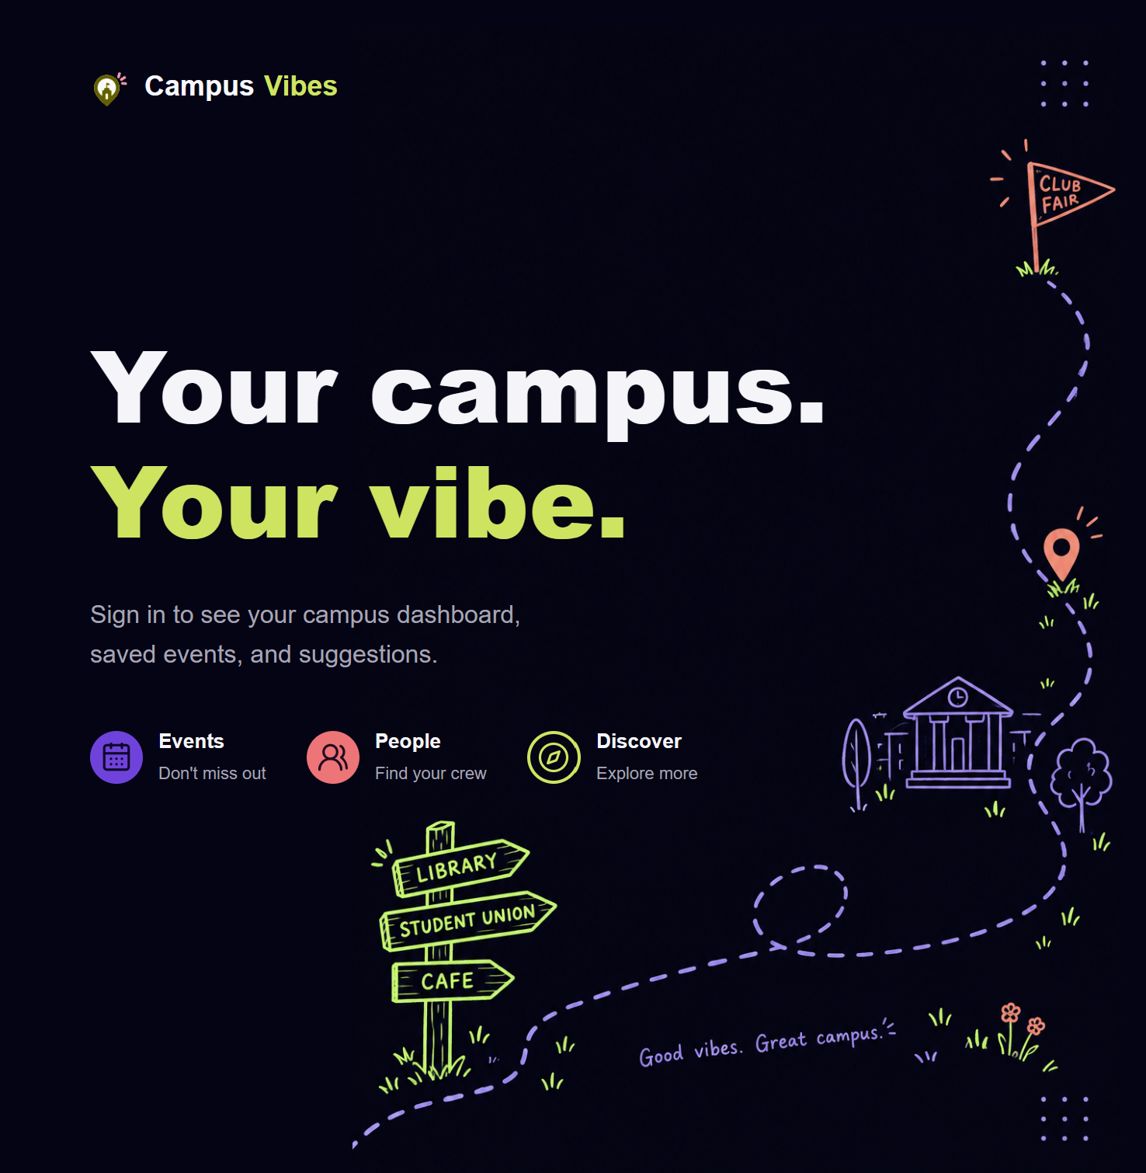
TEAM 4 / CAMPUSVIBES
Next steps after midterm
1. Verify Firestore
Test event loading if database access is available.
2. Fix Critical Issues
Prioritize and resolve bugs affecting core features.
3. Improve the Application
Use testing results and professor feedback to refine the application.
Goal: Make CampusVibes more reliable, functional, and user-friendly.

Slide 15
TEAM 4 / CAMPUSVIBES
Technical foundation
Frontend
Authentication
React + Vite
Firebase Authentication
Data
Modules
Firestore + local demo data
Discover • Feed • Profile • Assistant
Notes:
React and Vite power the frontend; Firebase supports authentication and cloud data, alongside local demo content.

Slide 16

TEAM 4 / CAMPUSVIBES
CampusVibes
Discover • Connect • Belong
Thank you!
We are happy to Answer your Questions
Team 4 Capstone Project
GitHub: CapstoneDesign-Fall2026-UlsanCollege/
Team_4_Capstone_project
Assigned by : Professor Benjamin W Slater
Notes:
Thank you for listening. We welcome your questions and feedback.

